Slide 1
Advanced Databases CSIS 638
Paul E. Anderson, Ph.D.
Department of Computer Science College of Charleston

Slide 2
Who am I?
Dr. Paul Anderson
Been with CofC for 7 years
I live in Mt P with my wife, twin identical boys, 3 dogs, and a parrot ☺
Outside of my research and teaching, I enjoy singing weird songs to my kids, woodworking, renovating my house, biking, fishing, kayaking, hiking, camping, tennis, and everything in between

Slide 3
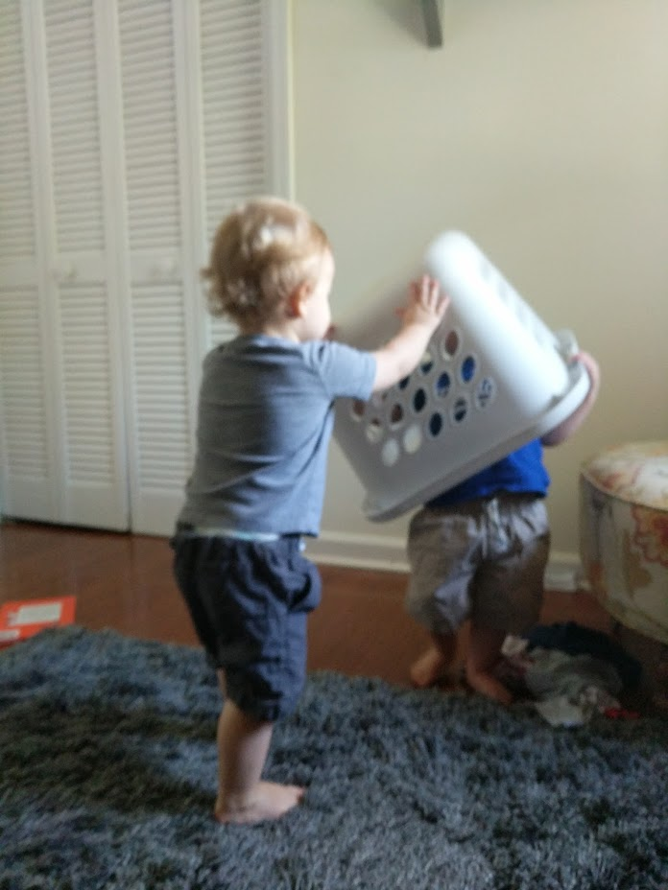

Slide 4
Introduction to the Course and Syllabus https://igards.github.io/education/courses/csis_638_2018_summer/syllabus

Slide 5
Thank you for listening!
Good luck with the course ☺

